Slide 1


Towards a Global History of the International Institute of Intellectual Cooperation:
Challenges and Opportunities
Rubén Rodríguez Casañ and Elisabet Carbó Catalan

Slide 2
Outline
Research framework and historical context
Goal and objectives
Sources and preprocessing
Example: the geographies of intellectual cooperation
Takeaways
Challenges / Questions

Slide 3
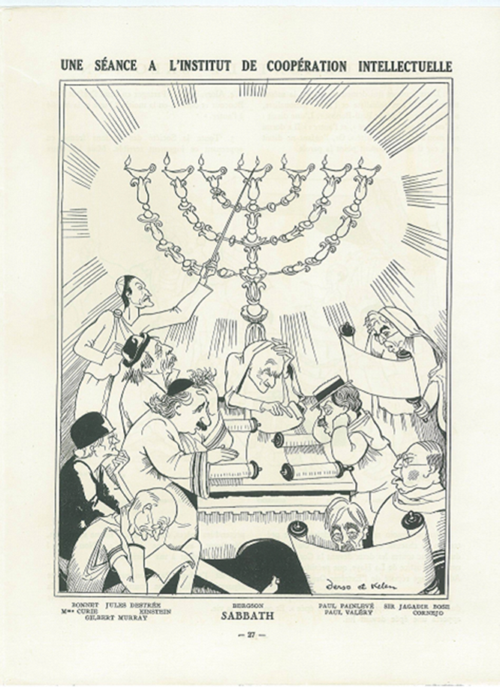
Research framework
ERC project Social Networks of the Past. Mapping Hispanic and Lusophone Literary Modernity (1898-1959), led by Diana Roig.
Subproject: institutions and institutionalization processes
International Institute of Intellectual Cooperation (Paris, 1926-1946)

Slide 4
Goal: “Towards a Global History of the International Institute of Intellectual Cooperation”
Global through the relational
Activities: Translation
Process 1: Translation in the internal activities of the IIIC
Process 2: Translation and literary cooperation
Process 3: Translation and scientific cooperation
Process 4: Translation and the emergence of an international legislation of intellectual property
Problematization of the object
The actors: Institutional boundaries in a cooperative task
The spaces: Geographies of intellectual cooperation
The definition: the translational aspects of cooperation
Methodology: complex system and social network analysis, data visualisation tools

Slide 5
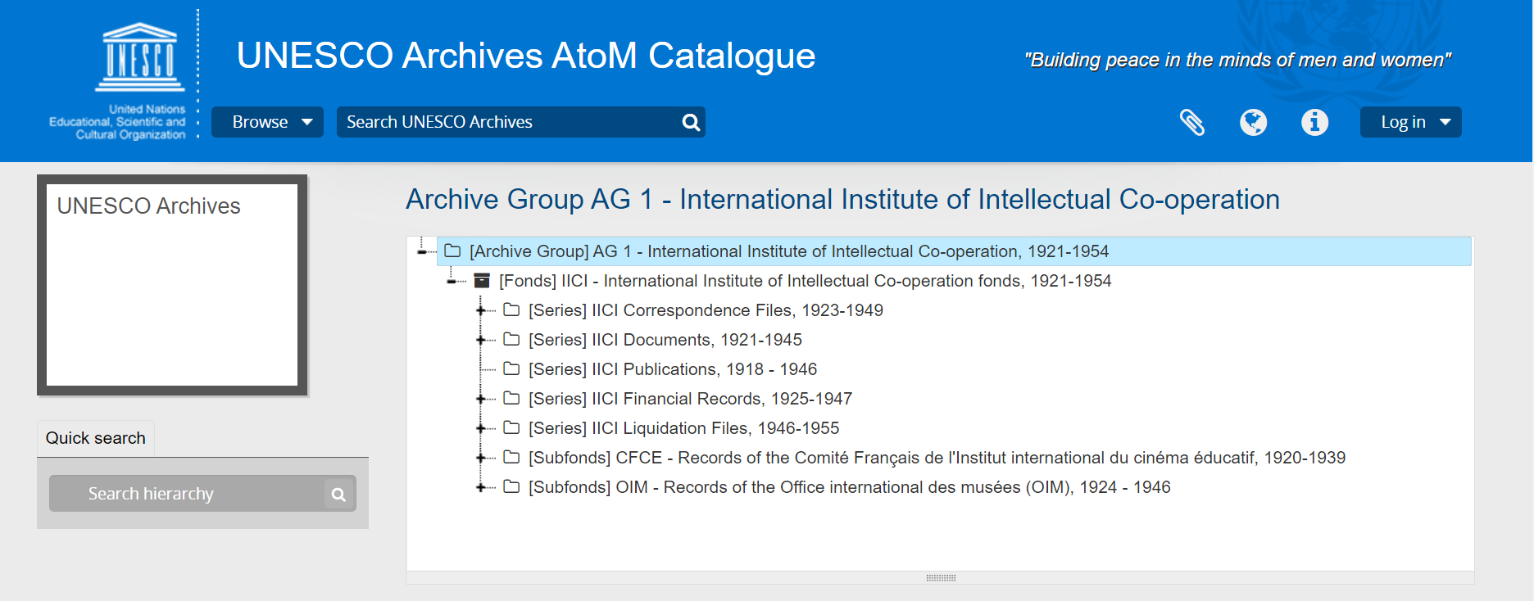
The archive of the IIIC

Slide 6
Goal: “Towards a Global History of the International Institute of Intellectual Cooperation”
Global through the relational
Activities: Translation
Process 1: Translation in the internal activities of the IIIC
Process 2: Translation and literary cooperation
Process 3: Translation and scientific cooperation
Process 4: Translation and the emergence of an international legislation of intellectual property
Problematization of the object
The actors: Institutional boundaries in a cooperative task
The spaces: Geographies of intellectual cooperation
The definition: the translational aspects of cooperation
Methodology: complex system and social network analysis, data visualisation tools

Slide 7
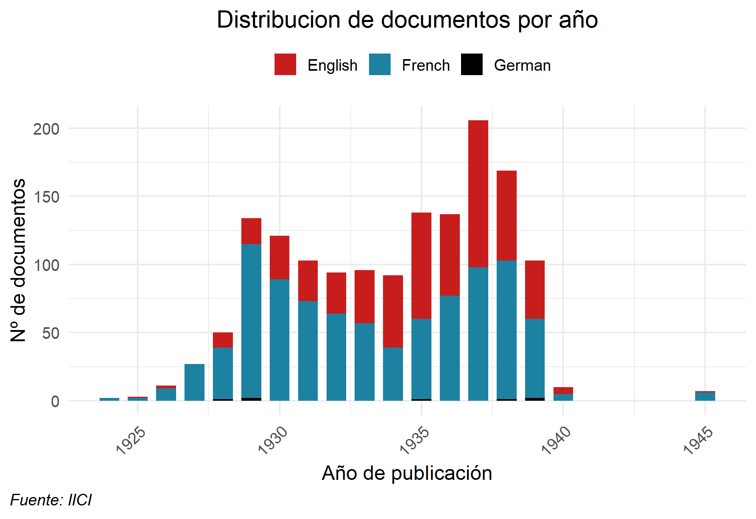
Language use in documents: evolution [metadata]

Slide 8
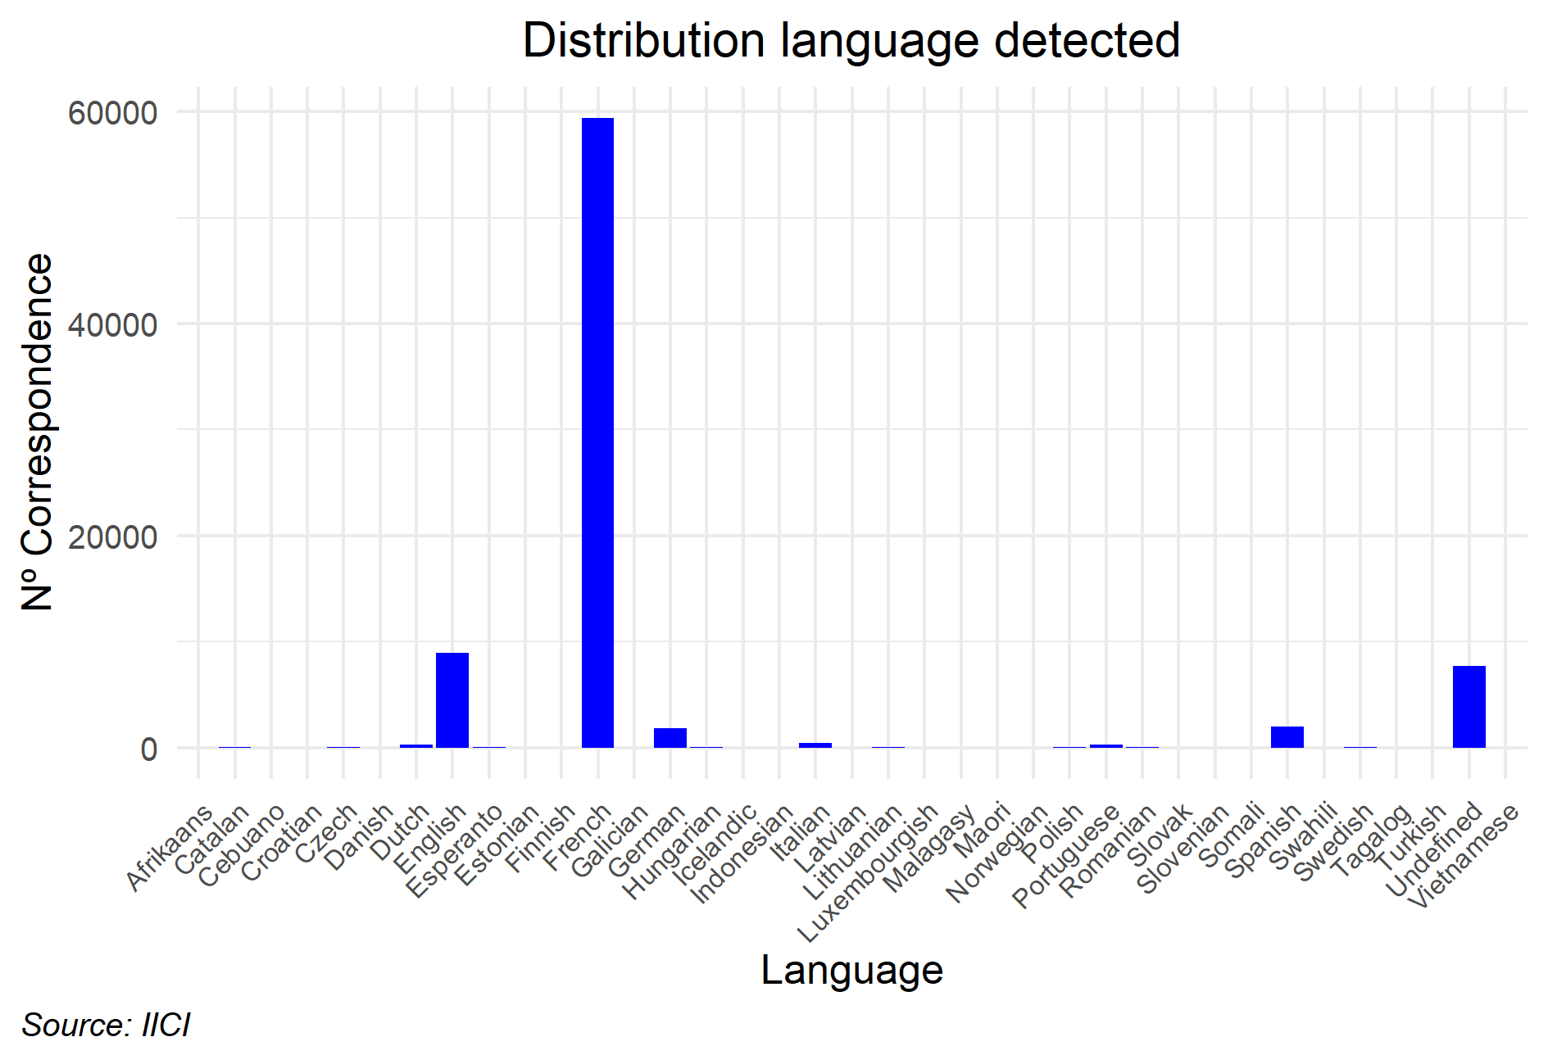
Language use in correspondence
[5 libraries of natural language detection]

Slide 9
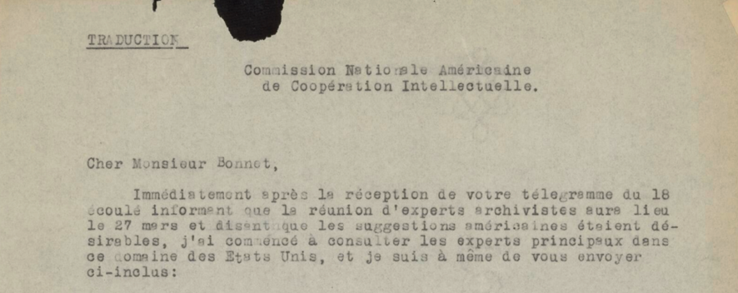
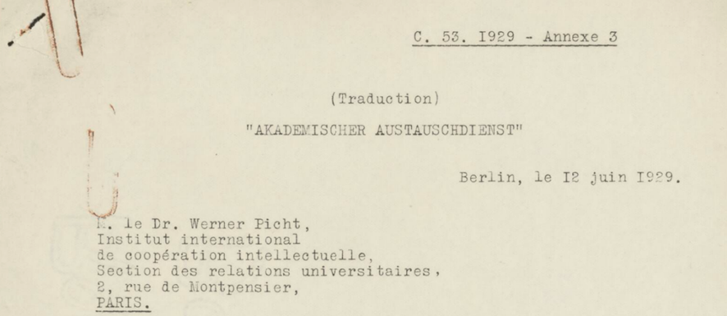
Language use in correspondence or in preserved version of correspondence?

Slide 10
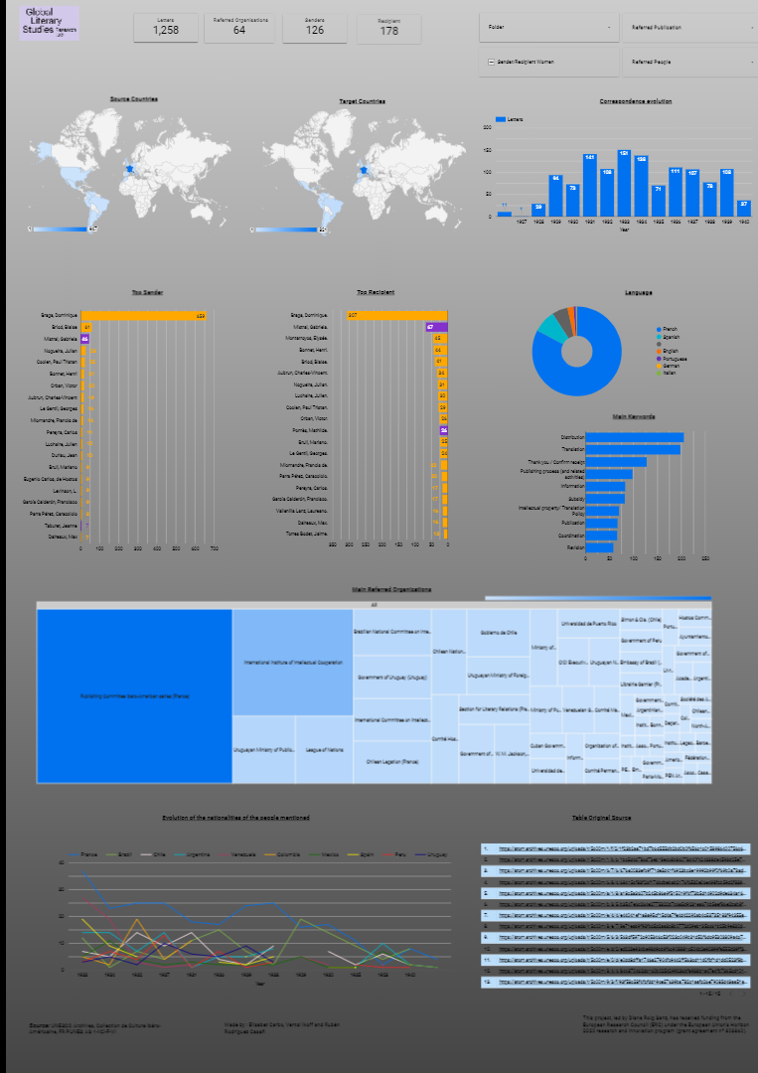
Navigating the Ibero-American Collection:
Dashboard
[manual indexation]

Slide 11
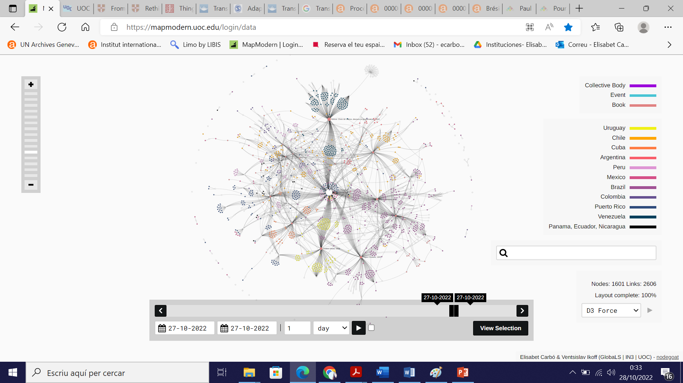
Notes:
MapModern | Login | Data | nodegoat (uoc.edu)
Scenario correspondence + books

Slide 12
The geographies of intellectual cooperation: complementary methods
1. Geographies of actors
1. Explicit mentions of countries in the letters
2. Implicit mentions of countries [cities] in the letters
3. Correspondence flows: location of sender and receiver
4. Co-occurrence network
2. Geography as object: mentions in the content
3. Exclusions: what is not in our visualisations?

Slide 13
Preprocessing steps 1
146,561 scanned sheets (Folders A and F)
Distinction between empty and written sheets (a consequence of the digitization method).
Regrouping of sheets belonging to the same document.
A division of the corpus between manuscript and machine-written materials by using deep learning models (to maximize quality in light of too uneven results of Optical Character Recognition).
The identification of letters (in opposition to attached documents) by using Random Forest and Support Vector Machine models.
(1)
(1)
60,594 predicted empty sheets
85,967 predicted written sheets
(2)
81,343 documents
(3)
(3)
62,192 predicted typewritten documents
19,151 predicted handwritten documents
(4)
(4)
18,166 predicted letters
44,026 predicted as attached documents

Slide 14
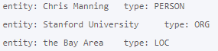
Preprocessing steps 2
From this set of identified letters, we used a name entity recognition (NER) library (Stanza), together with lists of city and country names in different languages, to identify a set of cities and countries mentioned in the letters.
Manual cleaning process
Location entity similarity algorithm (Levenshtein Distance + Chars2Vec)
RESULT: List of explicit countries + List of implicit countries (cities) mentioned in correspondence

Slide 15
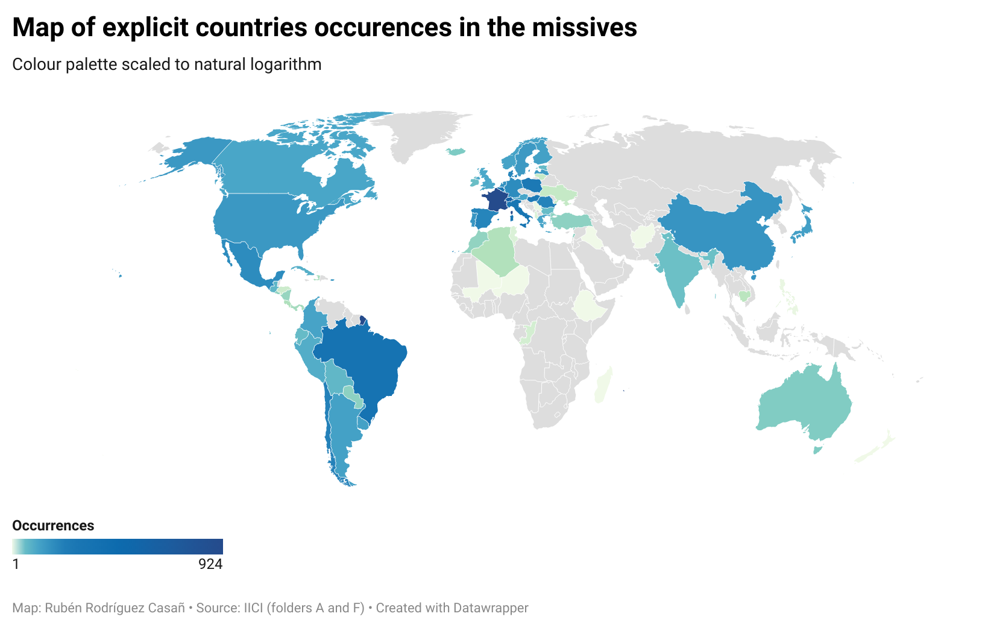
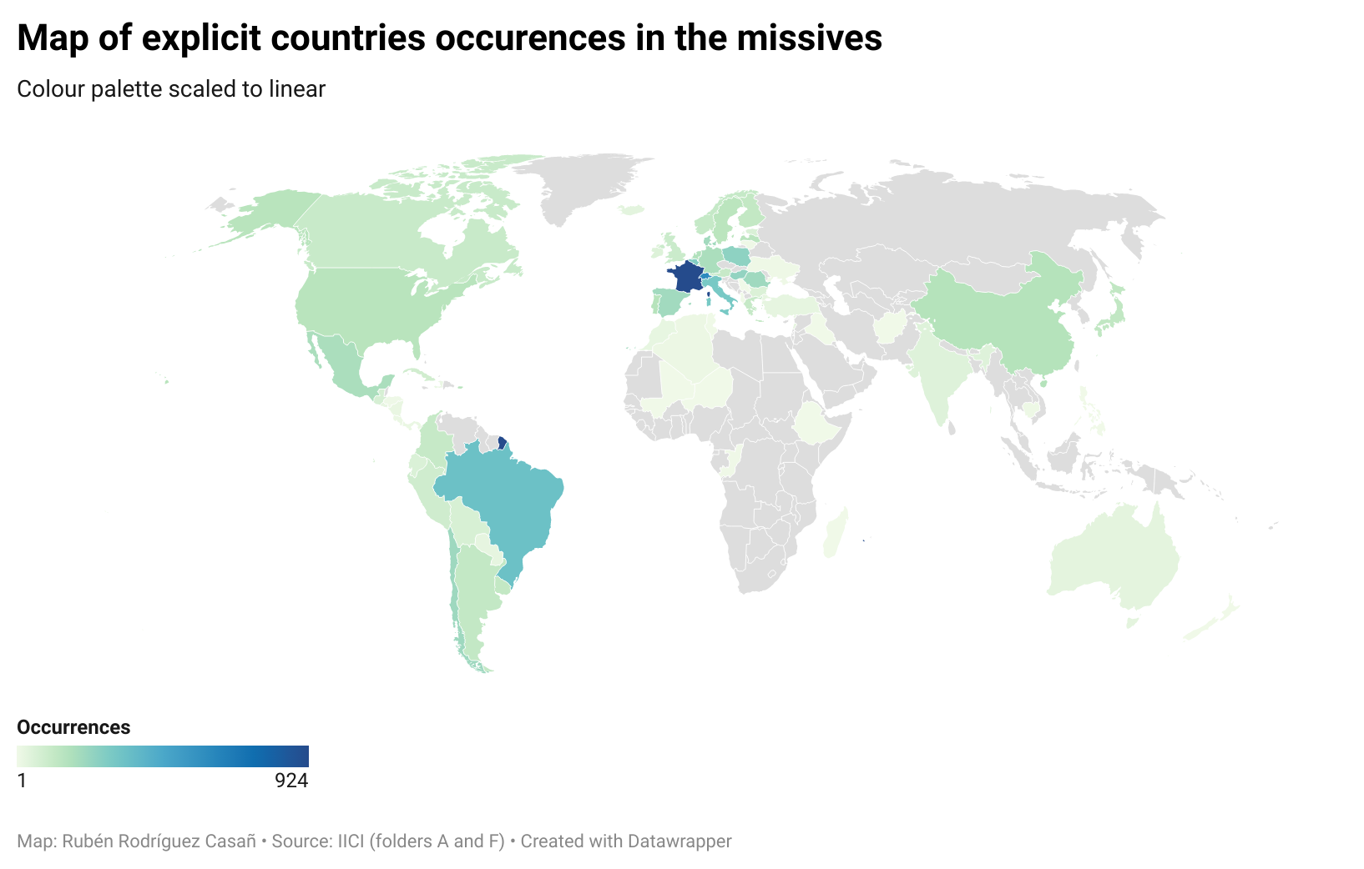
Geographies 1: Explicit mentions in letters
France is the first most mentioned country by far ahead of the rest of the countries.
Switzerland, followed by other European countries and some American countries were of secondary importance.
Most African and Asian countries are not listed.

Slide 16
Geographies 1: Explicit mentions in letters
Same conclusions
Which is the correct map?
BOTH

Slide 17

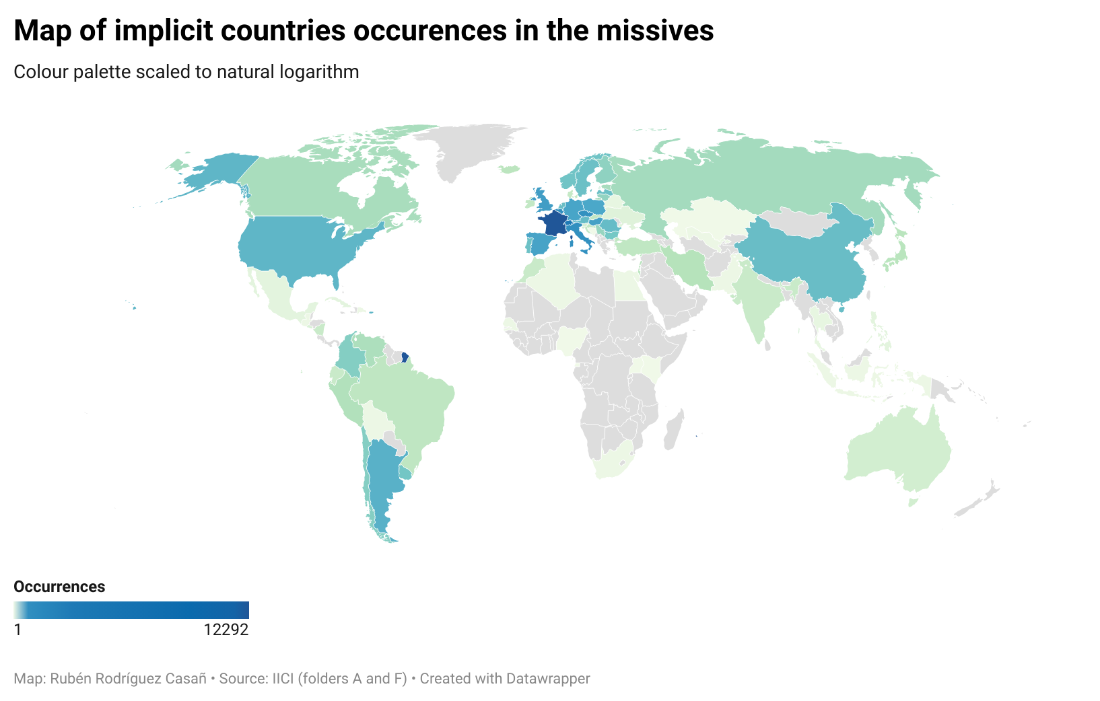
Geographies 2: Implicit mentions in letters
ITALY = 1 Mention
FRANCE = 1 Mention

Slide 18
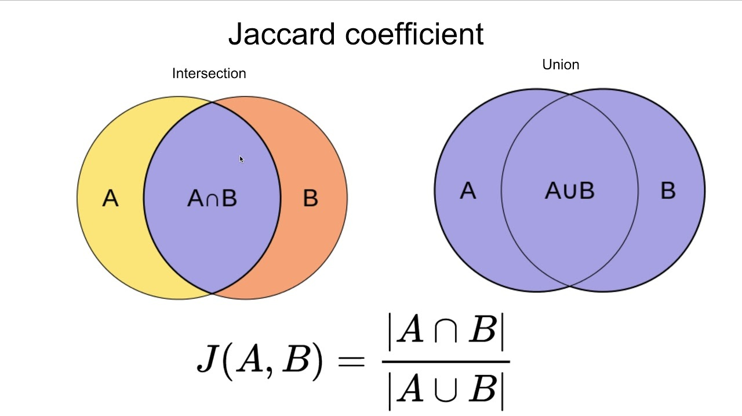
Criss-crossing results: Similarity between maps. Jaccard index
List A (explicit mentions) : [FRA][SPA]...[ITA]
List B (implicit mentions): [FRA][SPA]...[AUS]
Degree of overlap:
Jaccard index: 0.57
Matching countries: 54
Non-matching countries: 41

Slide 19
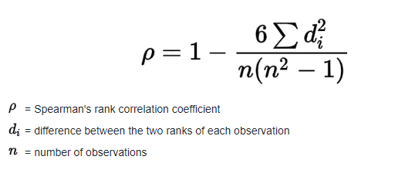
Criss-crossing results: Overlapping between differents ranks
Top | Correlation Value | Correlation Degree
5 | 1 | Monotonic correlation
10 | 0.86 | Very strong
20 | 0.43 | Moderate
50 | 0.13 | Very week
The most mentioned countries occupy the same positions in both lists, but differences increase with less-mentioned countries

Slide 20
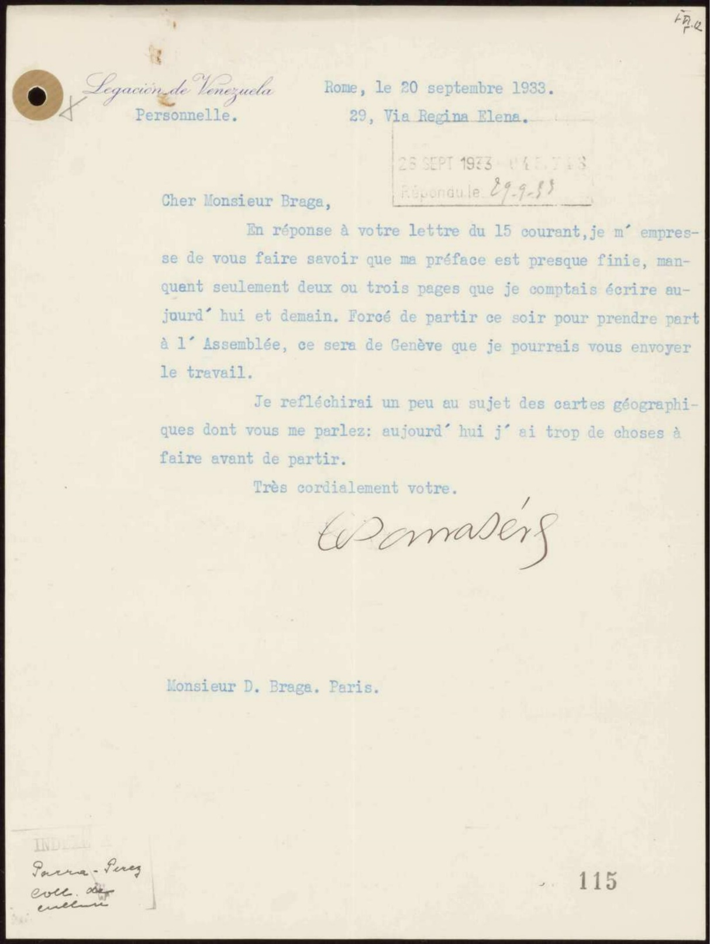
Geographies 3: Co-occurrence cities
Goal: Identifying co-occurrence of sender and receiver.
Challenge: different formats of letters → impossible to apply a universal criterion for the identification of sender/receiver.
Solution: we work with the beginning and end of each letter, where the city of origin/destination appears.
Roma
k = 1 letter
Paris

Slide 21
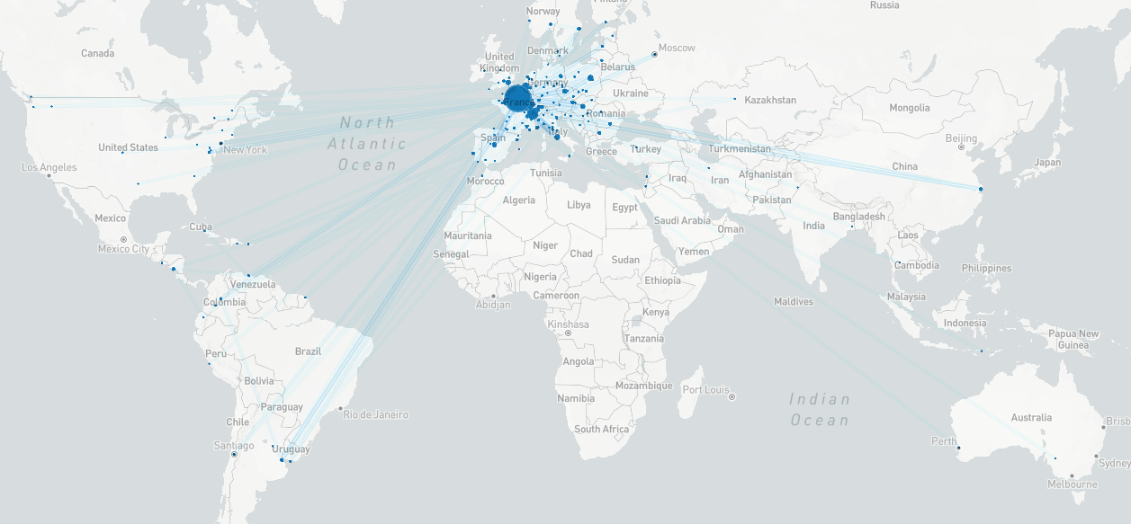
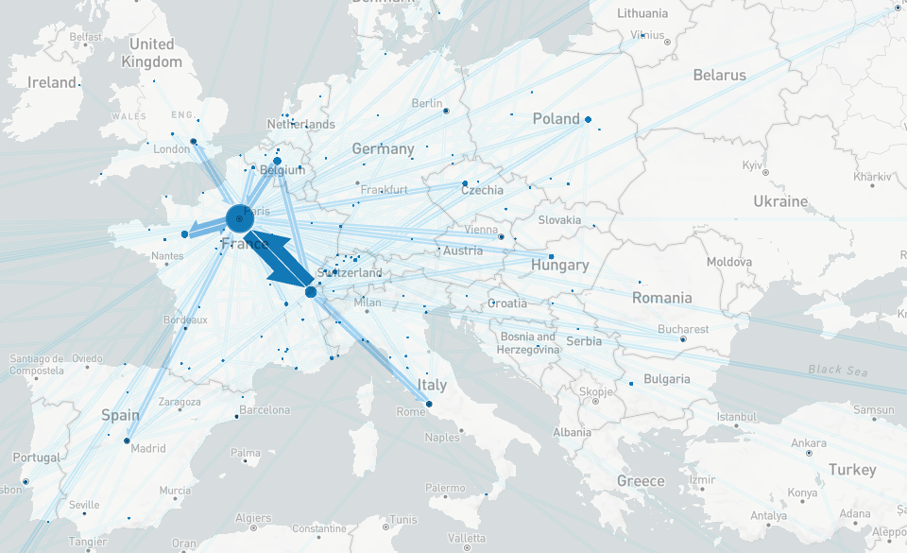
Geographies 3: Co-occurrence cities

Slide 22
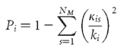
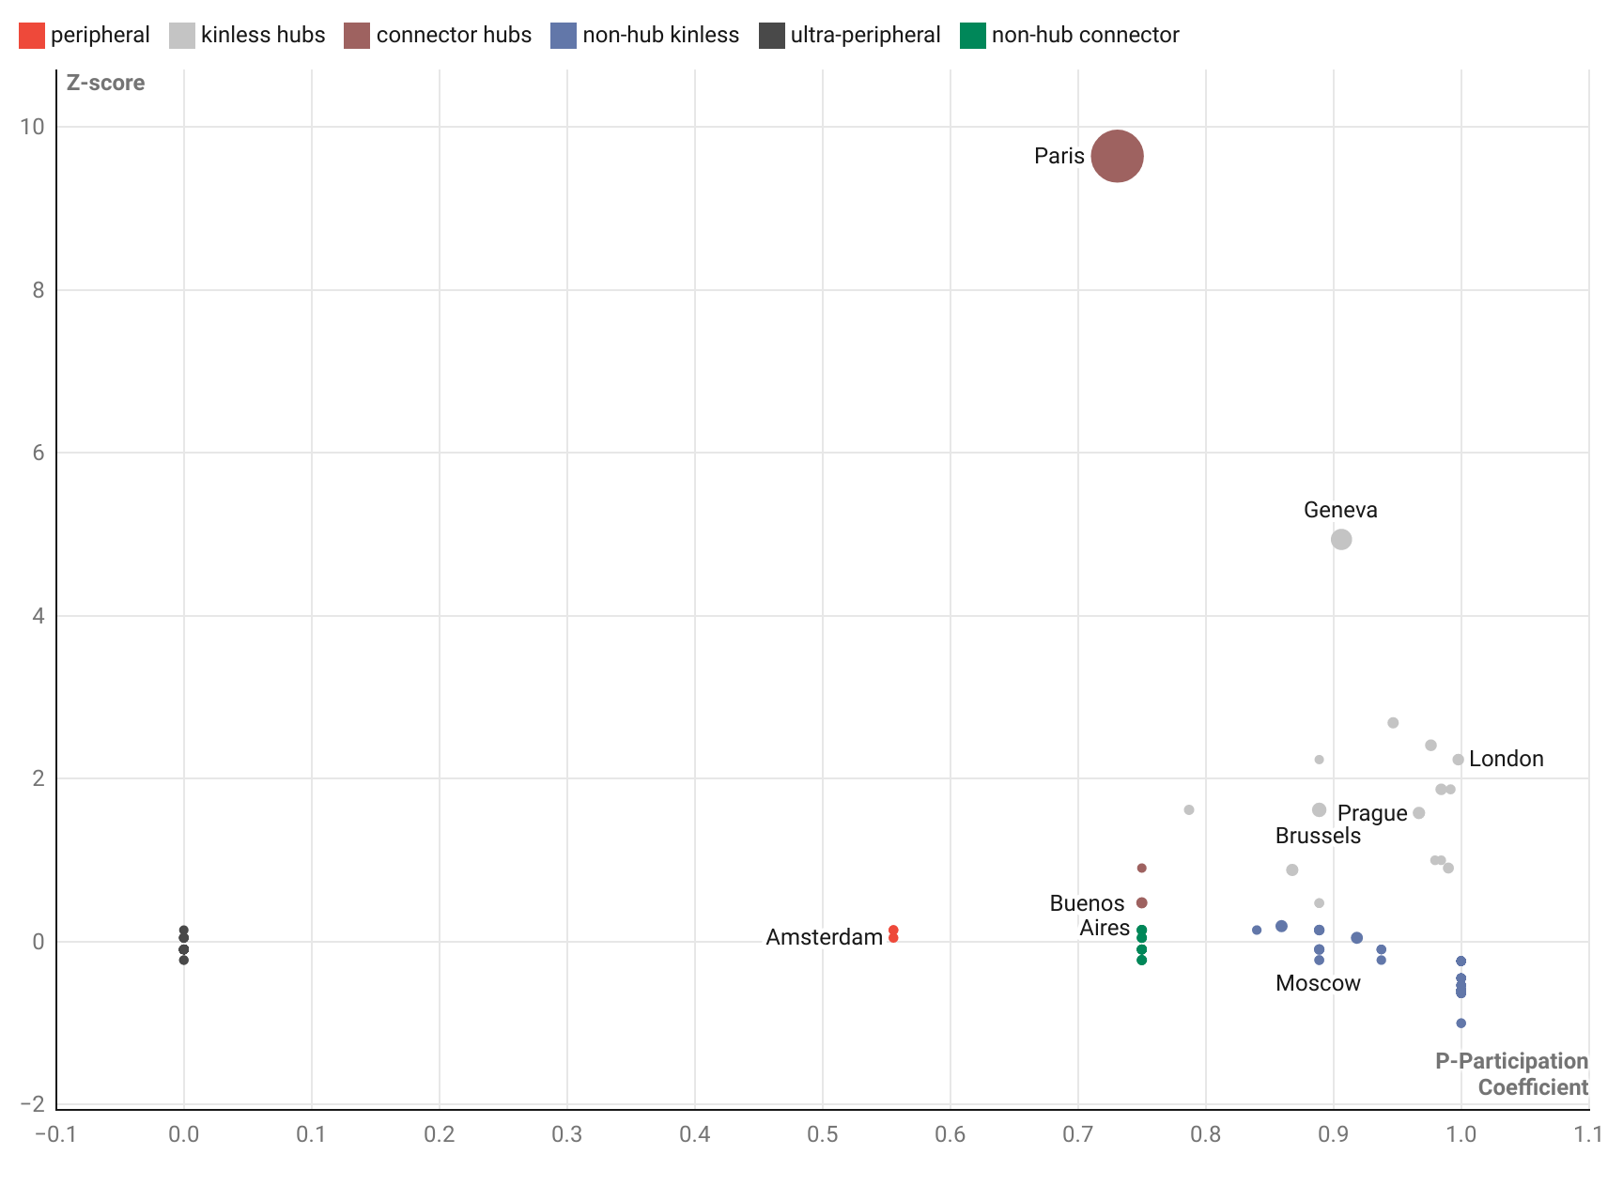

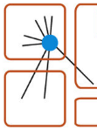
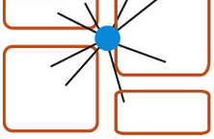
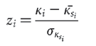
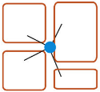

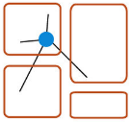
Current work: Co-occurrence cities - cartography
Source: Guimerà, R., Amaral, L. A. N. “Functional cartography of complex metabolic networks” Nature 433, 895–900 (2005). https://doi.org/10.1038/nature03288

Slide 23
Takeaways
Complementary functions of visualizations:
analysis of the dataset, illustration of results and formulation of new hypothesis
Confirmation of previous knowledge ↔ Validation of methodology ↔ Generate new knowledge
Questioning of the self-explanatory character of visualizations → Acknowledging the possible biases and being pedagogical in the dissemination stage, especially in the humanities.

Slide 24
Questions
? Contemporary maps for geographic visualizations
? Tips to represent different results with a similar list pattern:
Few elements at the head of the list with high results.
Long tail of the list, with however very low occurrences of each element.
? Aesthetical aspects

Slide 25



Thank you!
ecarboc@uoc.edu
History of translation, cultural diplomacy and international cultural relations, digital humanities, historical networks
rrodriguezcasan@uoc.edu
Data visualization, Machine learning, analysis of complex system

Slide 26
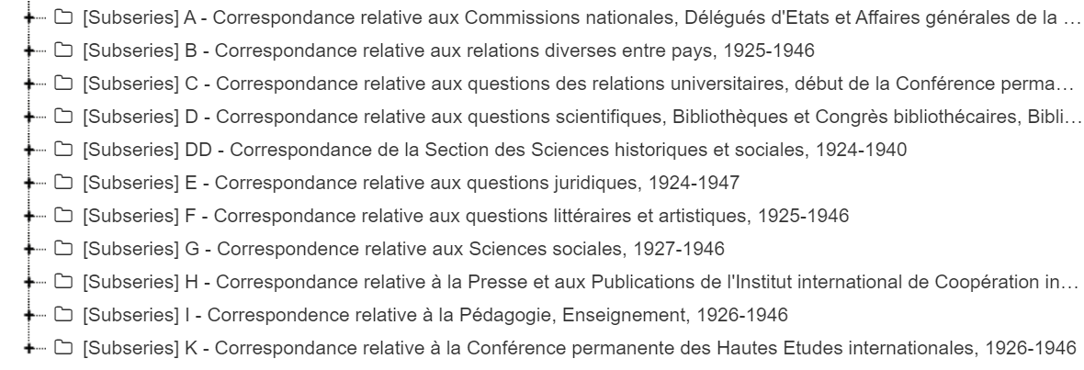
Future steps
Cross actor / place / organizations / topic

Slide 27
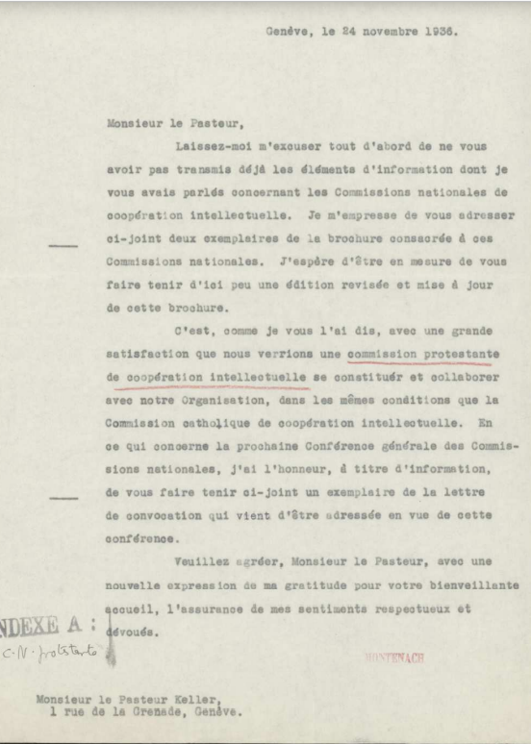
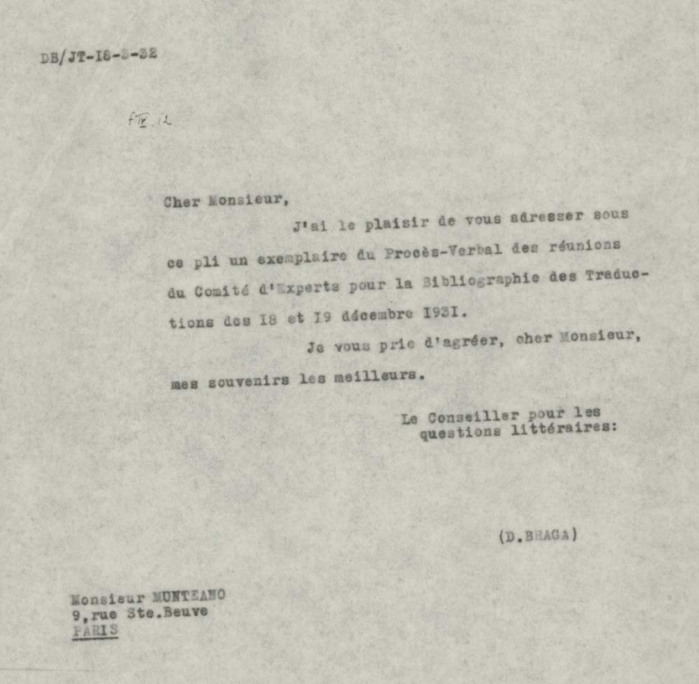
Sender / Recipient

Slide 28
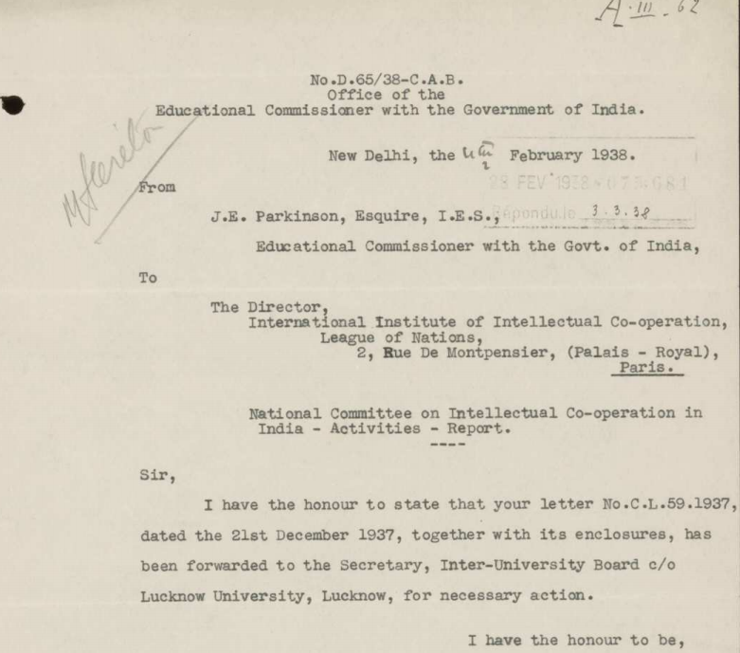

Slide 29
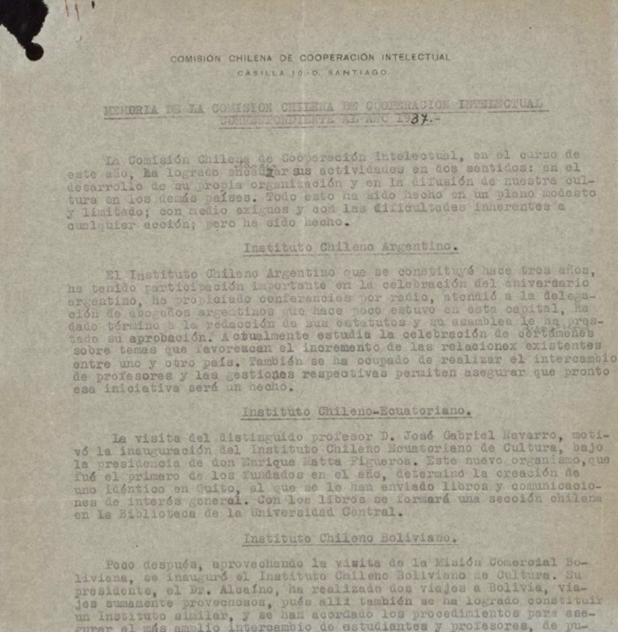
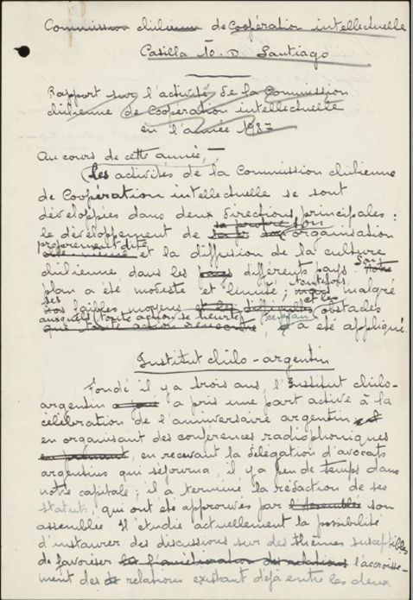
Notes:
Translations

Slide 30
